Slide 1

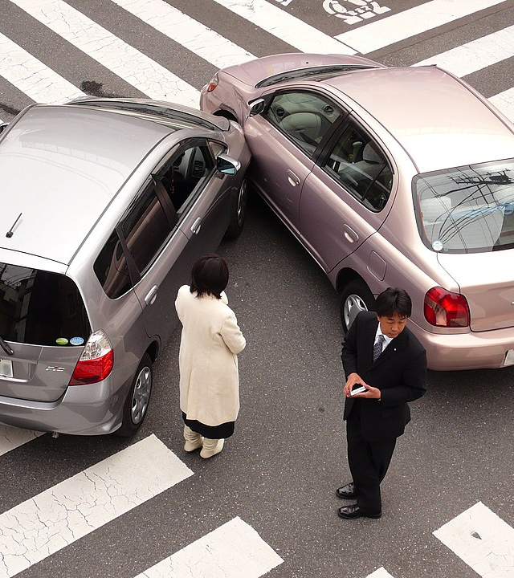
CHICAGO CAR Crashes
OLAIDE KASHIMAWO
This Photo by Unknown Author is licensed under CC BY-SA

Slide 2
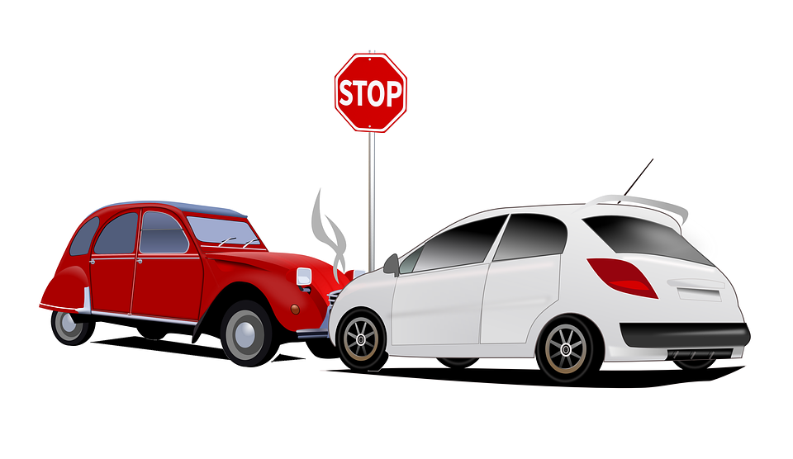
DATA SET
This data is the Chicago Police Department crash data set. There were three datasets that we observed
Crash=https://data.cityofchicago.org/resource/85ca-t3if.csv
Vehicle=https://data.cityofchicago.org/resource/68nd-jvt3.csv
Person=https://data.cityofchicago.org/resource/u6pd-qa9d.csv:
This data set contains almost 500,000 car crash records.
It lists the crash date, location, time, number of units, cause, road conditions, weather, traffic, construction zone, and severity of the crash are also included.

Slide 3
Business understanding
Chicago Emergency Medical Services
build software that predicts what causes accidents that could lead to injury.
Help 911 dispatchers
This project builds a multi-classification model to identify the primary cause of crashes

Slide 4
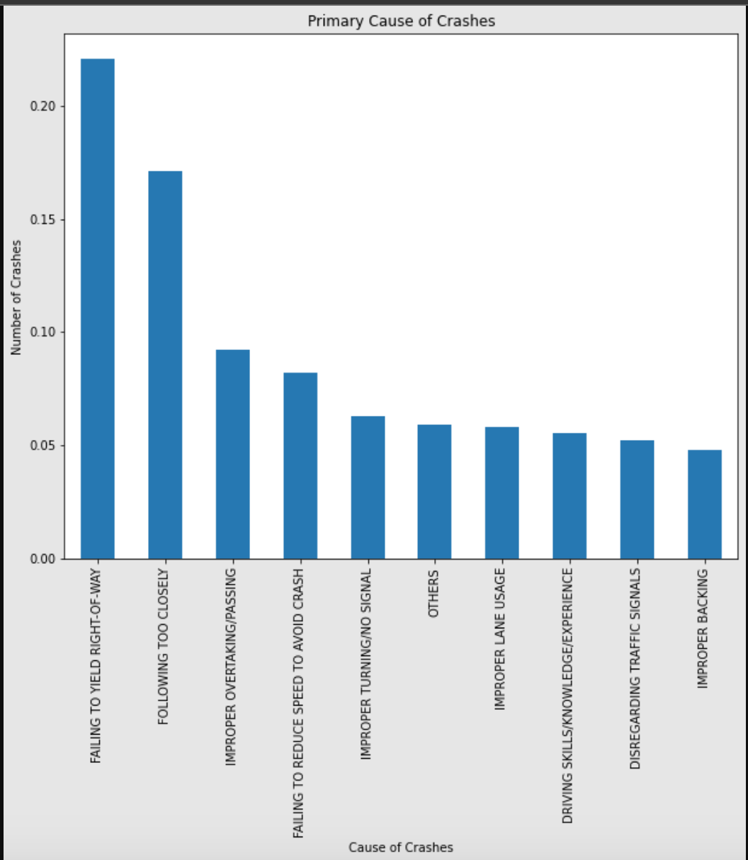
Primary Cause of CRASHES
The chart shows primary causes of car crashes in Chicago.

Slide 5
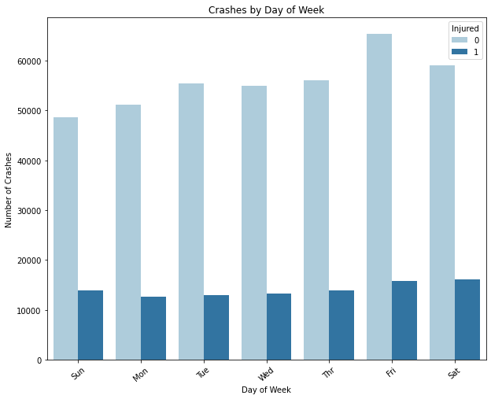
Crashes by day of week
Most accidents occur on Fridays and Saturdays
No injury = 0 , Injury = 1

Slide 6
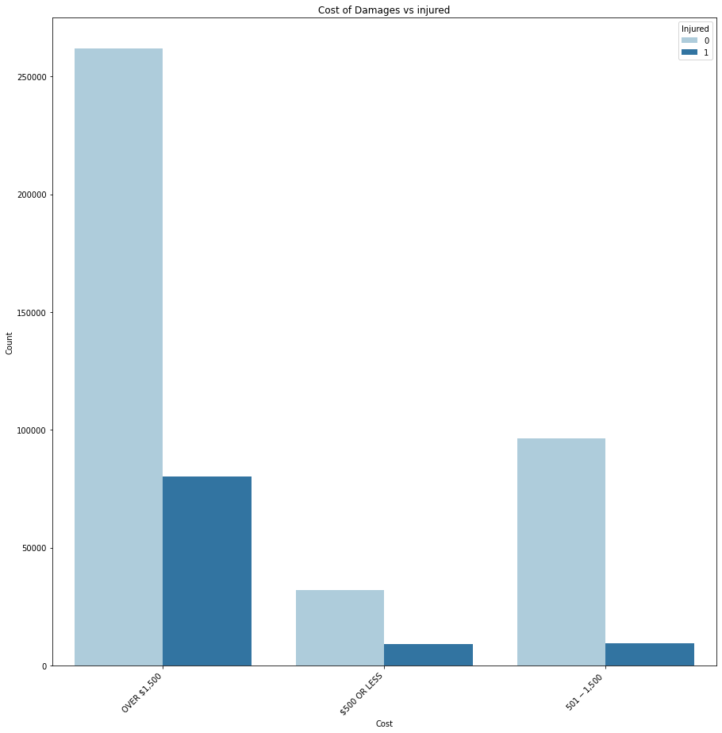
Cost of damages
Most severe and non severe accidents damage cost is more than $1500
No injury = 0 , Injury = 1

Slide 7
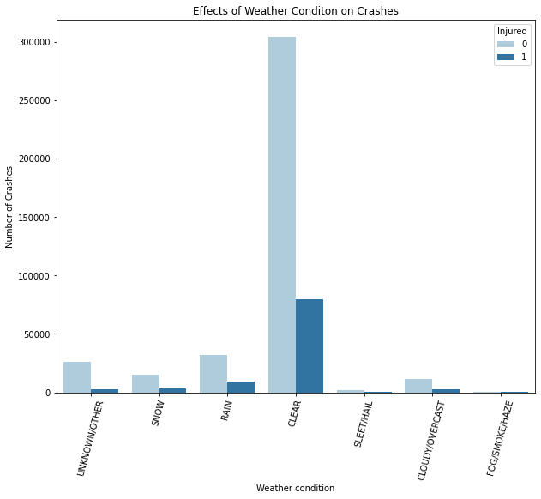
Weather condition
Most crashes occur in clear weather conditions.

Slide 8
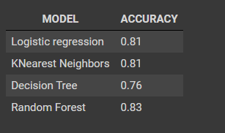
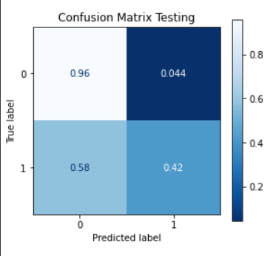
RESULT
Random Forest Classifier returned an accuracy rate of 83%
Confusion matrix of Random forest

Slide 9
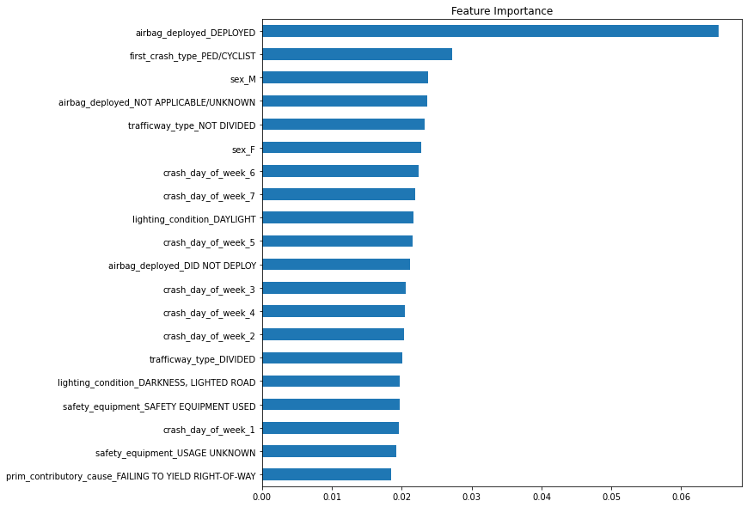
Feature Importance
This chart shows the top 20 vehicle crash severity predictors.
The airbag deployed, Ped/Cyclist, Male, and Airbag deployed have the highest coefficients with injuries/accidents

Slide 10
RECOMMENDATIONs
Increase enforcement of traffic laws and regulations, particularly with respect to distracted driving and failure to maintain a proper lane.
Installation of physical barriers between opposing lanes of traffic, wider lanes,
Encourage the use of advanced driver assistance systems (ADAS) for instance blind spot detection, lane departure warning, and automatic emergency braking.
The city can increase traffic signs/signals and lanes that are more ped/cyclist friendly

Slide 11
Next Step
Binning data to find crash locations can suggest lowering a speed limit or adding a traffic signal soon.
Crash type and Driver behavior

Slide 12
Thank you email:goldprint3@outlook.com

